Slide 1


Lab Automation
" Power Up Your Lab Efficiency with a Sparkling New Electrical Web Dashboard!"

Slide 2

Introduction
The thirst for learning, upgrading technical skills and applying the concepts in real life environment at a fast pace is what the industry demands from IT professionals today. However busy work schedules, far-flung locations, unavailability of convenient time-slots pose as major barriers when it comes to applying the concepts into realism. And hence the need to look out for alternative means of implementation in the form of laddered approach.

Slide 3

Benefits
Our Electrical Web Dashboard offers a variety of beneﬁts, including: real-time monitoring of energy usage, automated alerts for potential issues, and data visualization tools to help you identify
areas for improvement.

Slide 4

Features
Our Electrical Web Dashboard includes a range of features such as: customizable dashboards to ﬁt your lab's speciﬁc needs, historical data tracking to identify trends, and energy cost analysis to help you save money.

Slide 5
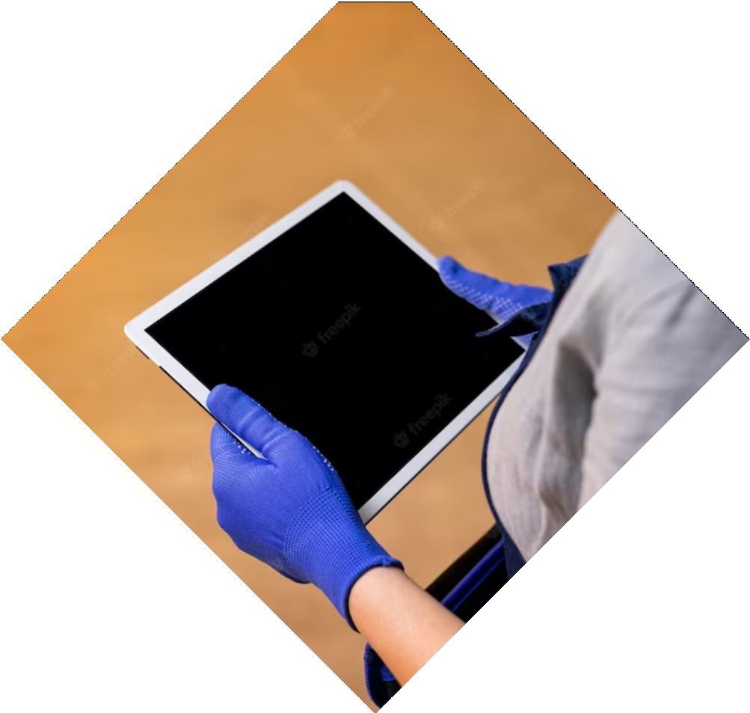
Ease of Use
Our Electrical Web Dashboard is designed to be user-friendly and easy to navigate.
You can access it from anywhere with an
internet connection and customize it to display the information that matters most to you.

Slide 6
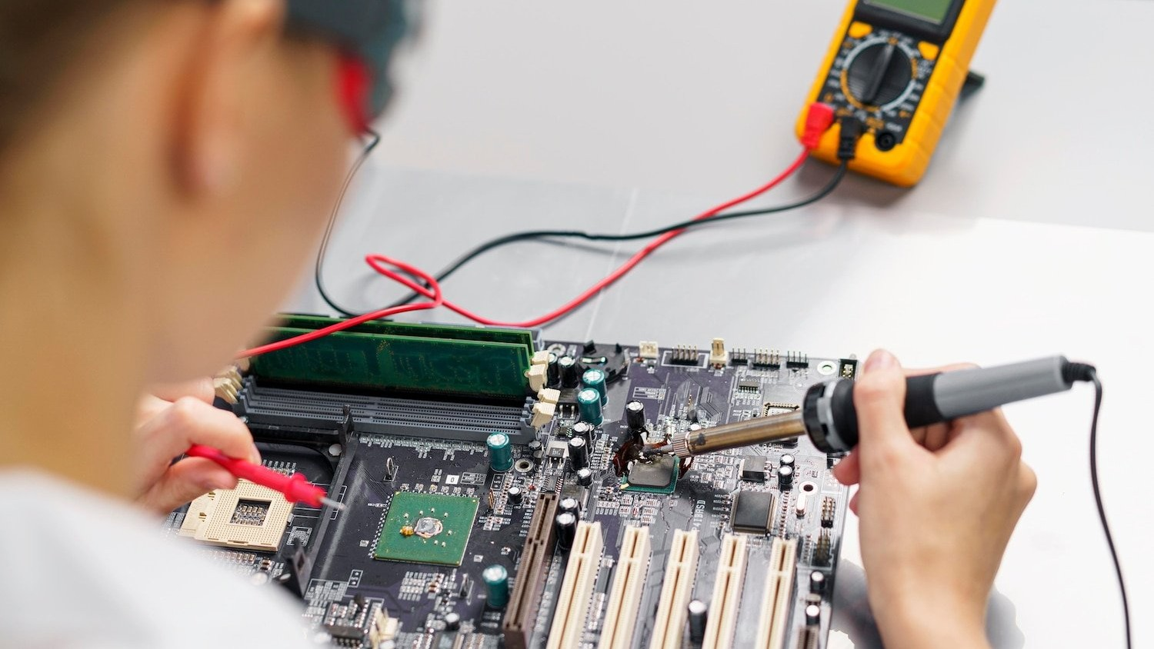
Compatibility
Our Electrical Web Dashboard is compatible with a wide range of electrical systems, including smart meters and sensors. It can also be integrated with other lab management software to streamline your workﬂow.

Slide 7


Security
We understand the importance of data security in a lab setting. Our Electrical Web Dashboard uses encryption and authentication protocols to ensure your data is safe and secure.

Slide 8

Testimonials
Don't just take our word for it! Here's what some of our customers have to say about our Electrical Web Dashboard: 'It's made a huge difference in our lab's energy efﬁciency.' - Dr. Smith, 'The data visualization tools are incredibly helpful.' - Dr. Johnson

Slide 9
Conclusion
Thank you for considering our Electrical Web Dashboard. With its range of features, ease of use, and data security protocols, we believe it's the best solution for improving your lab's energy efﬁciency.
Contact us today to learn more!

Slide 10
Thanks!
Do you have any questions?
addyouremail@freepik.com
+91 620 421 838
Click Here!

